Slide 1



P. R. Pote (Patil) College of Engineering & Management, Amravati (An Autonomous Institute) Department of Artificial Intelligence and Data Science
Presentation on
AIdATAHUB – E-LEARNING
Presented By
1) Pranav Chikte 2) Aditya Shrirao
3) Tushar Bundele 4) Gaurav Raut
5) Yogesh Thakare
Guided By
Prof. P. G. Angaitkar
Year 2024-25

Slide 2
Abstract
E-learning platforms offer flexible access to educational resources, transforming how people learn.
However, learners often struggle with scattered and unreliable materials, making it hard to follow structured learning paths.
To solve this, we propose an e-learning platform that curate free resources into organized collections, linking directly to original sources for credibility and ease of access. Built with HTML, CSS, JavaScript, Node.js, and MongoDB, the platform will feature user authentication, CRUD operations, and a responsive interface.
This solution aims to simplify learning, improve resource accessibility, and help users achieve their educational goals efficiently.

Slide 3

Introduction
A modern educational platform focused on AI and Data Science resources for engineering students.
AIData is a web-based platform designed to provide curated learning resources for student interested in AI, Data science, and related field.
The platform features :
Roadmaps for different engineering career paths.
2. Video library for educational content.
3.Blogs and articles about AI and data science topics.
4.Responsive design that works on all devices.

Slide 4
AIM & Objectives
The aim of the AIDataHub project is to develop a modern, user-friendly, and responsive web platform that provides curated educational resources, career roadmaps, video content, and insightful articles to help engineering students effectively learn and explore the fields of Artificial Intelligence and Data Science.
OBJECTIVE
To provide structured career roadmaps in AI and Data Science for engineering students.
To offer curated video content and articles for self-paced learning.
To build a responsive and modern web platform accessible across all devices.
To create a performance-optimized UI using Tailwind CSS and vanilla JavaScript.

Slide 5
Problem Statement
Many engineering students interested in AI and Data Science struggle to find reliable, organized, and beginner-friendly learning resources.
There's a need for a dedicated platform that brings together career roadmaps, educational videos, and articles in one place to guide and support their learning journey.
Solution :
Develop a responsive web platform that offers structured career roadmaps, video tutorials, and informative articles focused on AI and Data Science.
Ensure easy access and smooth user experience using modern technologies like Tailwind CSS and performance optimizations like lazy loading.

Slide 6
Literature Survey
Platforms like Coursera, edX, and Roadmap.sh offer AI and Data Science content.
Most of them are too broad or not beginner-friendly for engineering students.
Some platforms require payment for full access to courses.
There is no single platform that combines roadmaps, videos, and articles for AI/DS in one place.
A need exists for a free, easy-to-use learning platform focused on engineering students.

Slide 7

Idea / Methodology
Key Finding Feature Development
AI adoption trends were security features were prioritized
identified deu to data privacy concerns.
Research Overview Design Influences A literature survey on AI and data User feedback indicated a need management was conducted. for better accessibility.
Study Implications
User feedback will guide future enhancements.
All diagrams of proposed system

Slide 8
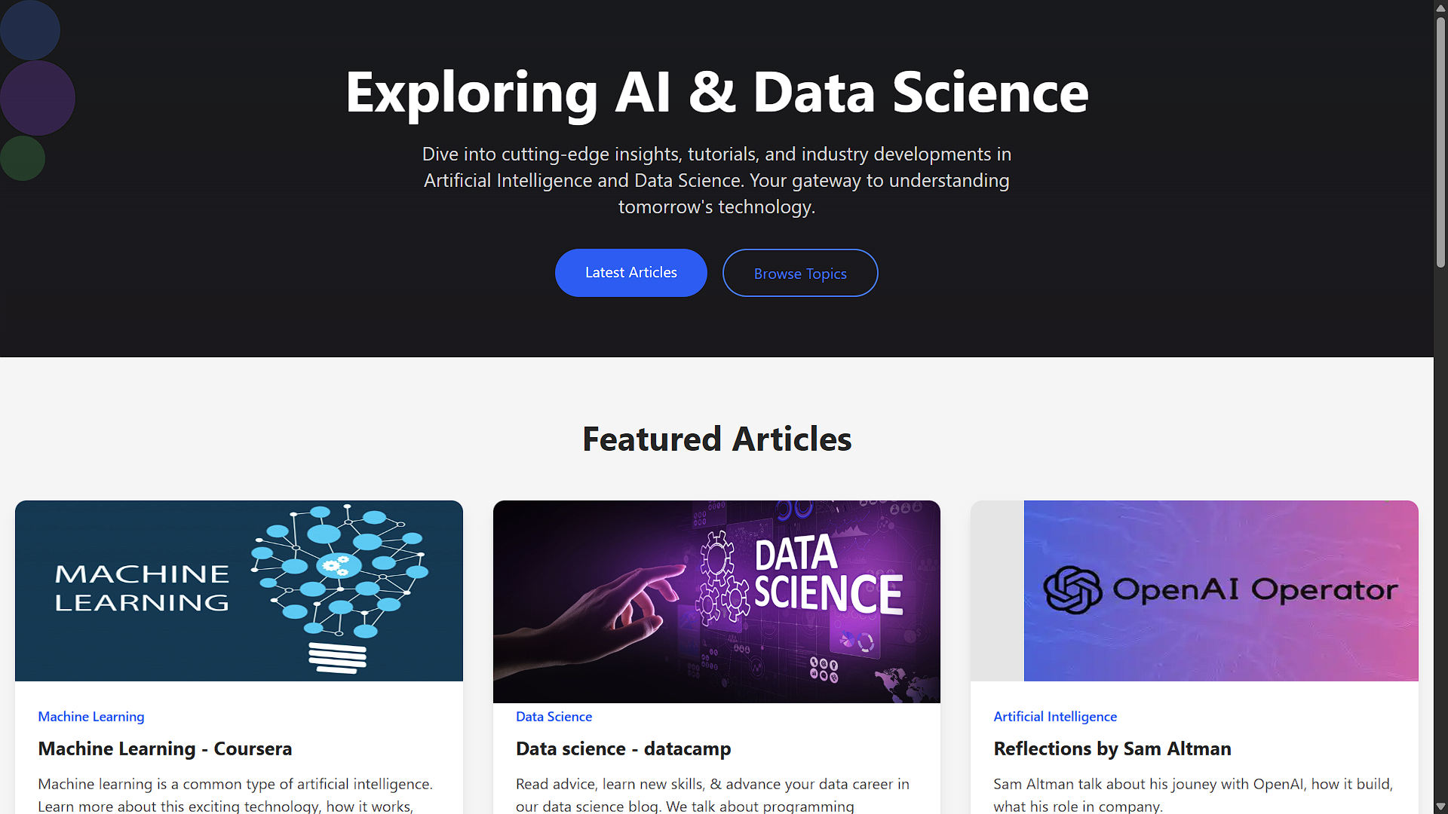
Screen shots/ Results

Slide 9
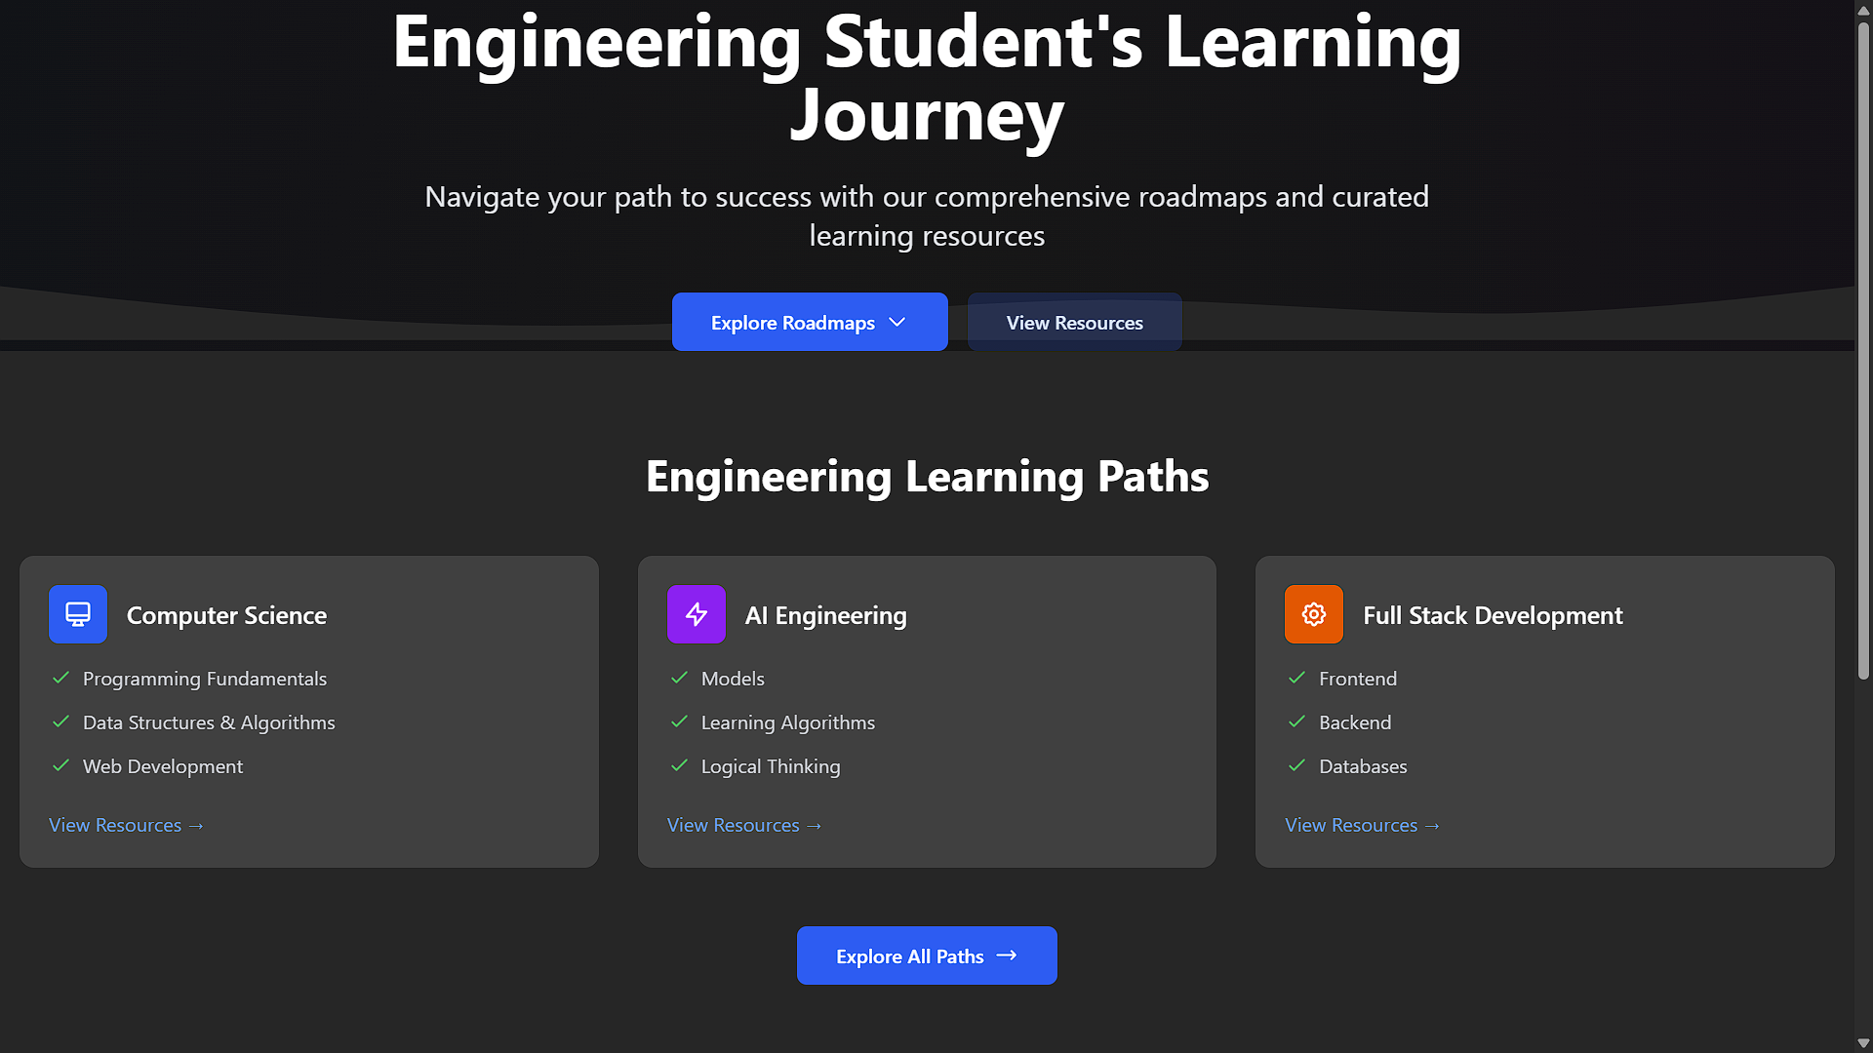
Result Analysis

Slide 10
Opportunities and Challenges
Opportunities :
1. Technical Growth :
- Hands-on experience with modern web development technologies
- Implementation of responsive design principles
2. Community Building :
- Platform for knowledge sharing among students
- Networking opportunities between learners and educators
challenge faces :
1. Technical Challenges :
- Implementing responsive design across various devices and screen sizes
- Optimizing performance while maintaining rich content delivery
- Significant loading time issues with video content pages affecting user experience.
2.Content Management :
- Curating and organizing educational content effectively.
- Ensuring content quality and accuracy.
- Keeping learning resources up-to-date with rapidly evolving AI field.

Slide 11
Conclusion
AIDataHub offers a centralized platform for AI and Data Science learning.
It is designed specifically for engineering students.
Provides career roadmaps, videos, and articles in one place.
Uses Tailwind CSS and vanilla JavaScript for a clean, responsive UI.
Ensures a smooth experience across mobile, tablet, and desktop.
Helps students easily access and follow a structured learning path.
Bridges the gap between scattered resources and guided learning.

Slide 12
References
1.Tailwind CSS Documentation https://tailwindcss.com/docs
2.Roadmap.sh – Developer Career Roadmaps https://roadmap.sh/
3.MDN Web Docs – HTML, CSS, and JavaScript https://developer.mozilla.org/
4.YouTube & FreeCodeCamp.org – Open educational video content https://www.youtube.com/ https://www.freecodecamp.org/
5.GitHub – For version control and open-source collaboration https://github.com/

